Slide 1

The Coronavirus Pandemic System Integrated Control
Adam Adkins, Alexander Sweeney & Scott Caldwell

Slide 2

WHAT IS THE CPSIC?
An automated system for booking appointments, storing results and tracking the coronavirus within the Kent State University Health System

Slide 3

Requirements

Slide 4
CPSIC Functional Requirements
Schedule
Store
Store the patient health results
Record
Record payment for the visit
Prepare
Prepare a schedule of booked visits
Generate
Generate reports of earned money
Visualize
Visualize COVID-19 Cases
Alert
Alert KSU campuses when a COVID-19 case is confirmed within KSU
Schedule patient visits

Slide 5
CPSIC NON-Functional Requirements
Secure
Only authorized users can access various information
Available
Users should always be able to access it
Maintainable
It should be easily maintained over time

Slide 6
Fulfilling These Requirements Security
Users will be required to login to use the system
Patients can only access their own data
Personnel will be given access through the principle of least privilege
An audit history of changes will be kept

Slide 7
Fulfilling these Requirements Availability
The system will be accessible via webpage
Service will be hosted by a cluster of load-balanced servers
Service will have frequent backups
Service will be constantly monitored to quickly detect any outages

Slide 8
Fulfilling these Requirements Maintainability
The service will be designed in modules
Modules will be easily added or changed over time
It will accept many kinds of data in patient results
Database maintenance will be performed routinely

Slide 9

Software Design

Slide 10
Class Designs
Schedule
PersonnelSchedule
Report
AppointmentSlot
Personnel
Appointment

Slide 11
Class Designs
Visit
Invoice
Payment
Patient
TestResult
Test

Slide 12
Schedule

Slide 13
PersonnelSchedule
Inherits from Schedule

Slide 14
Report

Slide 15
Appointmentslot

Slide 16
Personnel

Slide 17
Appointment

Slide 18
Visit
Inherits from Appointment

Slide 19
Invoice

Slide 20
Payment

Slide 21
Patient

Slide 22
TestResult

Slide 23
Test

Slide 24
Class Relationships

Slide 25
Class Relationships

Slide 26
Class Relationships

Slide 27
Class Relationships

Slide 28
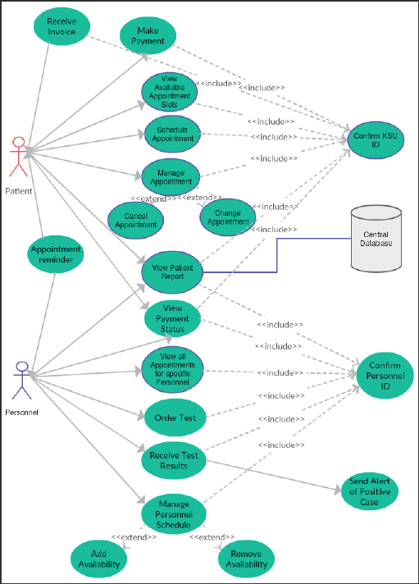
Use Cases

Slide 29
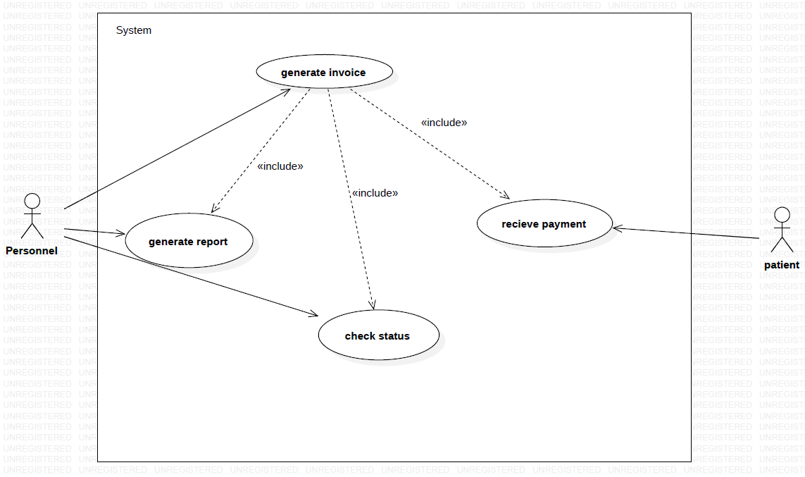
Use Cases

Slide 30
Packages

Slide 31

Executables

Slide 32
Executable Release: Setting a Personnel’s schedule
Goal:
Allows a Personnel to setup their availability for any day
Classes to be implemented:
Personnel, PersonnelSchedule, Schedule, AppointmentSlot
Previously implemented classes to use:
N/A
Use case to be implemented:
Determining if the personnel works a specific date and time
Inputs:
The personnel’s name, type, employeeID, and workingTimes.
Outputs:
The Personnel’s schedule will be used to make up an availability schedule for the month that patients can choose from to setup an appointment
Time for completion:
To be completed by April 20, 2020

Slide 33
Executable Release: Booking Appointments
Goal:
Allowing a patient to find a schedule of open appointment slots to book an appointment
Classes to be implemented:
Appointment, Patient
Previously implemented classes to use:
Personnel, Schedule, AppointmentSlot
Use case to be implemented:
Determining if the patient is a Student or faculty
Determining if the patient is seeing a therapist or nurse
Determining if the Appointment needs changed
Inputs:
The type, the patient the personnel, and the date/time of the appointment.
Outputs:
The appointment created will set the appointmentSlot to filled and update the schedule to show the appointment information and new availability.
Time for completion:
To be completed by April 21, 2020

Slide 34
Executable Release: Recording a Visit
Goal:
Keep track of each visit that takes place. Which Patient that is seen, the personnel that ran the appointment, the tests that were ran and their results, and the date of the appointment.
Classes to be implemented:
Visit, Test, TestResult
Previously implemented classes to use:
Personnel, Patient, Appointment
Use case to be implemented:
Determining which tests to run
Determining the results of the tests
Determining which type of appointment is set
Determining if an alert is needed to be sent
Inputs:
The patient, the personnel, the type, and the appointment of the visit.
Outputs:
The tests that were run and the subsequent results of those tests. Sends an alert if there is a positive test.
Time for completion:
To be completed by April 22, 2020

Slide 35
Executable Release: Creating Invoices and Payments
Goal:
Creating Invoices to send to patients showing them their cost of the visit, while also keeping track of if the patient has paid their bill.
Classes to be implemented:
Invoice, Payment
Previously implemented classes to use:
Visit
Use case to be implemented:
Determining they type of visit
Determining if the patient paid the invoice
Determining the type of payment
Inputs:
The visit, the cost, the amount paid, the date created and the reference number of the invoice
Outputs:
The invoice will be used for billing purposes and help in generating reports
Time for completion:
To be completed by April 23, 2020

Slide 36
Executable Release: Login System
Goal:
Verification that the person is allowed to access the system by checking their KSU ID against a database of KSU students and employees.
Classes to be implemented:
Patient, Personnel.
Previously implemented classes to use:
N\A
Use case to be implemented:
Determining if the patient has a KSUID
Determining if the patient is a student, faculty, nurse, or therapist
Inputs:
The person’s KSU ID
Outputs:
The KSU ID will be used to decide what kind of access the person will have to the system
Time for completion:
To be completed before launch of the website

Slide 37
Executable Release: Generating Reports
Goal:
To keep track of the running total of money earned by the different services offered. Also, to keep track of how many cases of positive corona virus tests there are at Kent State, and in Ohio.
Classes to be implemented:
Report
Previously implemented classes to use:
Invoice
Use case to be implemented:
Determining how much money was made by the different services
Determining the amount of positive cases
Inputs:
The date the report was generated and the data it contains
Outputs:
The amount of money earned from each service offered, the number of cases at KSU and in Ohio.
Time for completion:
To be completed by April 24, 2020

Slide 38
Questions?

